Slide 1

Shipment logistics analysis
By Nayyab Mir

Slide 2
Objectives
To analyse carrier performance using KPI’s such as on-time delivery of shipments
To identify and mitigate the risks associated with potential delivery delays
To predict the likelihood of delay for shipments to improve timeliness of deliveries in the future

Slide 3
Key Datasets for Analysis
GPS data
Shipment bookings data
New bookings data

Slide 4
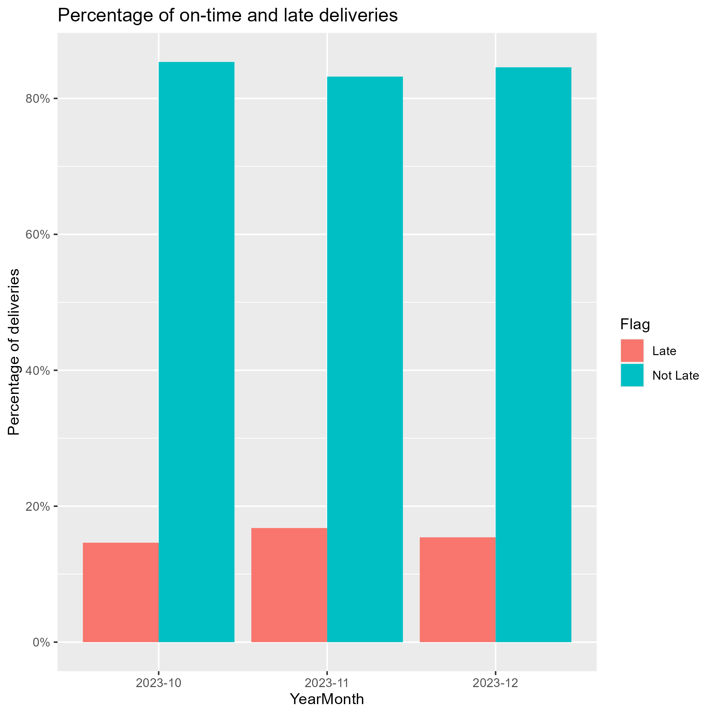
Timeliness of deliveries
84% of shipments met the on-time delivery threshold (arriving no later than 30 minutes past the last delivery scheduled time) between October 1st and December 31st 2023
There is also a consistent percentage of late and on-time deliveries between those months
The analysis showed that geographical data and vehicle size were the most significant factors

Slide 5
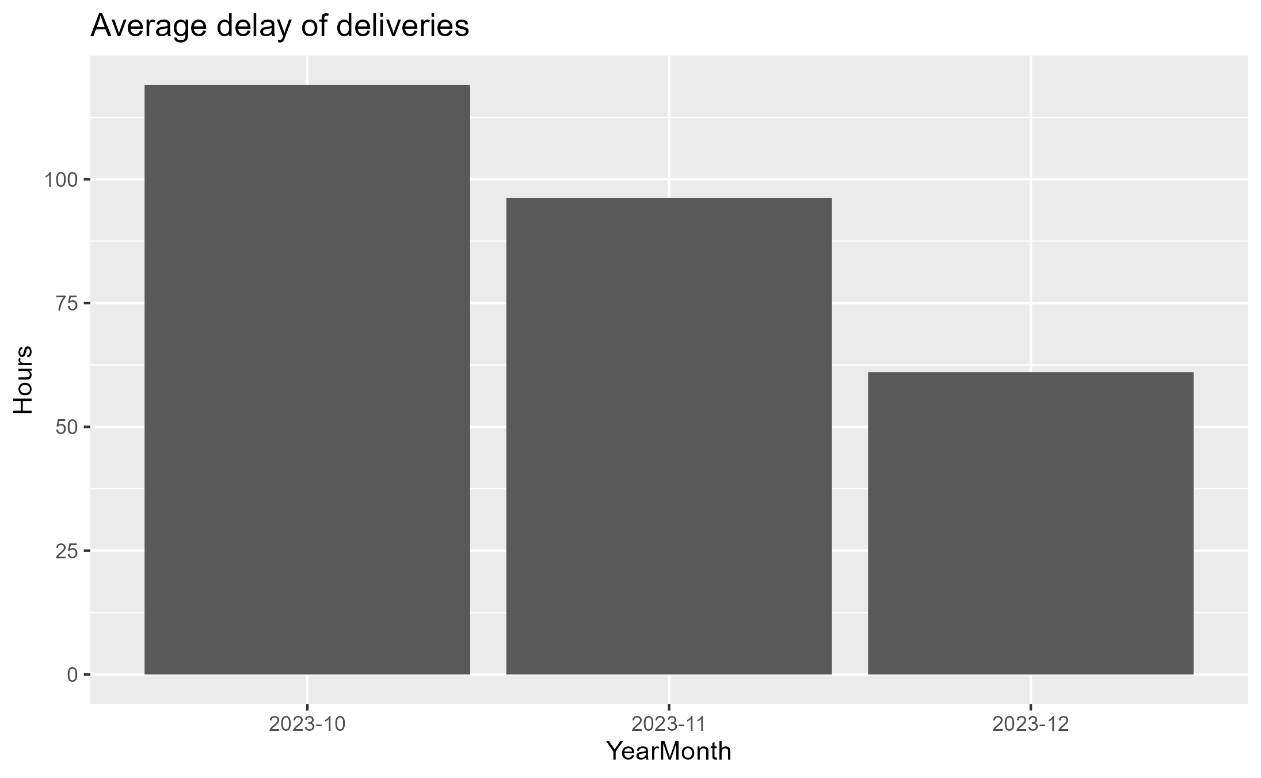
Analysing potential delays
There were reported significant delays of deliveries during the period between October 1st and December 31st 2023
The average delay of shipments has shown to reduce by approximately a half between those months
One key method of reducing the impact of potential delays is by notifying shippers in advance (30 minutes before the last scheduled time)

Slide 6
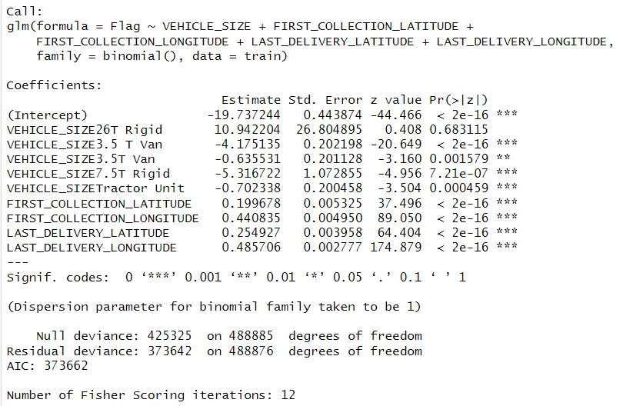
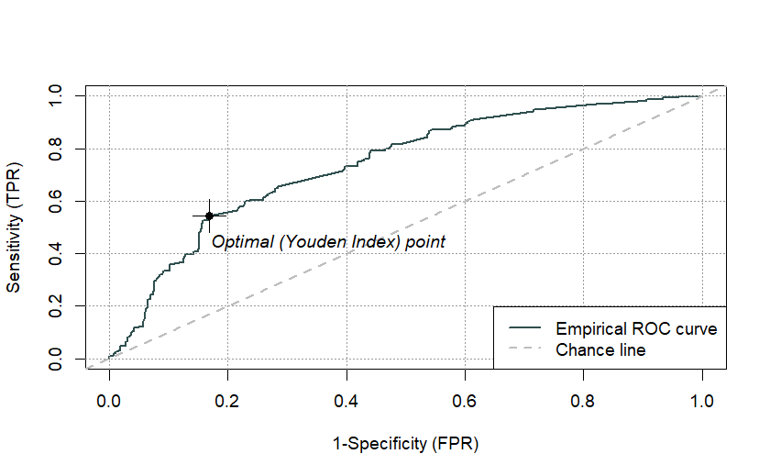
Predicting the likelihood of delay for shipments
A logistical regression model was fit on the shipment data to predict the likelihood of delay of shipments
McFadden’s R squared of 0.12, AUC of 0.74
The model was then tested out on new shipment bookings data

Slide 7

Key Takeaways
Evidential strong carrier performance of shipments with reduced delays over time
Suggested next steps involve:
Improve the accuracy of the predictive model
Identify and implement methods to mitigate risks of delay, i.e. notifying shippers in advance
Analyse more historical data from previous years

